Slide 1
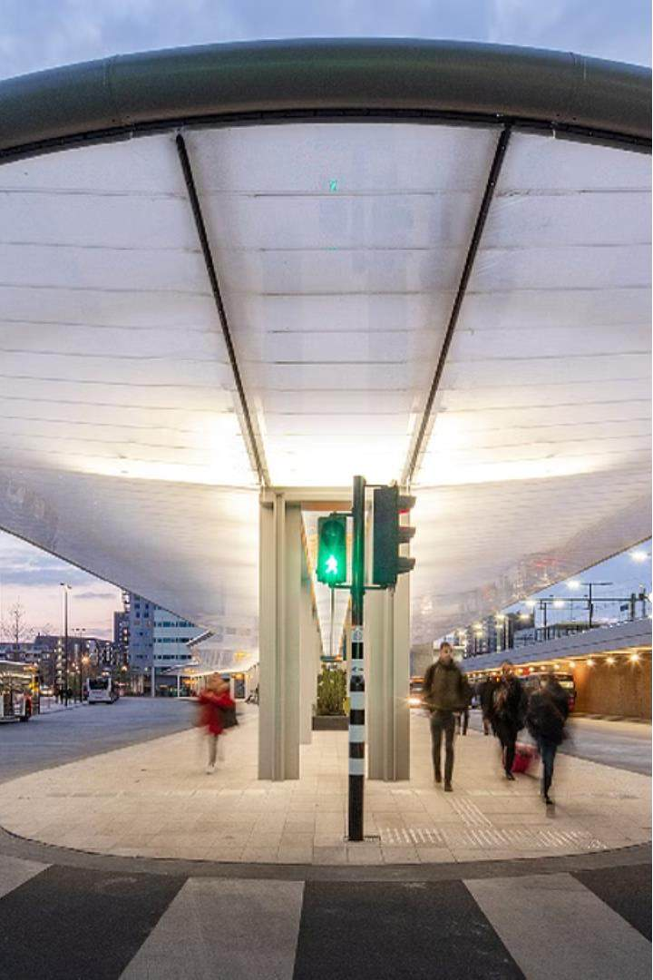
Bus Reservation
System
Project by:
M.Arun prasad (192210564)
M.Varshith (192211707) MSVN Hima sagar(192211780)
Guided by: Jayashakthi velmurgan

Slide 2

Scope of Aim
Real-Time Updates
Provide passengers with instant notifications about schedule changes, delays, and seat availability.
Efficient Fleet Management
Analyze data to optimize routes, schedules, and vehicle utilization for for improved operational efficiency.
1
Convenient Booking
Enable users to easily search, compare, and book bus tickets online or through mobile apps.
2
3

Slide 3

Existing Systems and Disadvantages
Paper-Based Reservations
Reservations
Lack of Transparency
Inefficient Operations
Limited information about bus schedules, availability, and real-time updates causes frustration for passengers.
Difficulty in managing routes, fleet, and resources leads to suboptimal utilization and increased costs.
Cumbersome and time- consuming process that often leads to long queues and delays.

Slide 4
Proposed System and Advantages
Real-Time Tracking
Passengers receive instant updates on bus locations, arrivals, and any schedule changes.
Enhanced Passenger Experience
Improved reliability, convenience, and responsiveness resulting in higher customer customer satisfaction.
Intuitive Booking
Streamlined online/mobile platform for easy
easy bus ticket booking and management.
Optimized Operations
Advanced data analytics to enhance route planning, fleet utilization, and resource allocation.

Slide 5
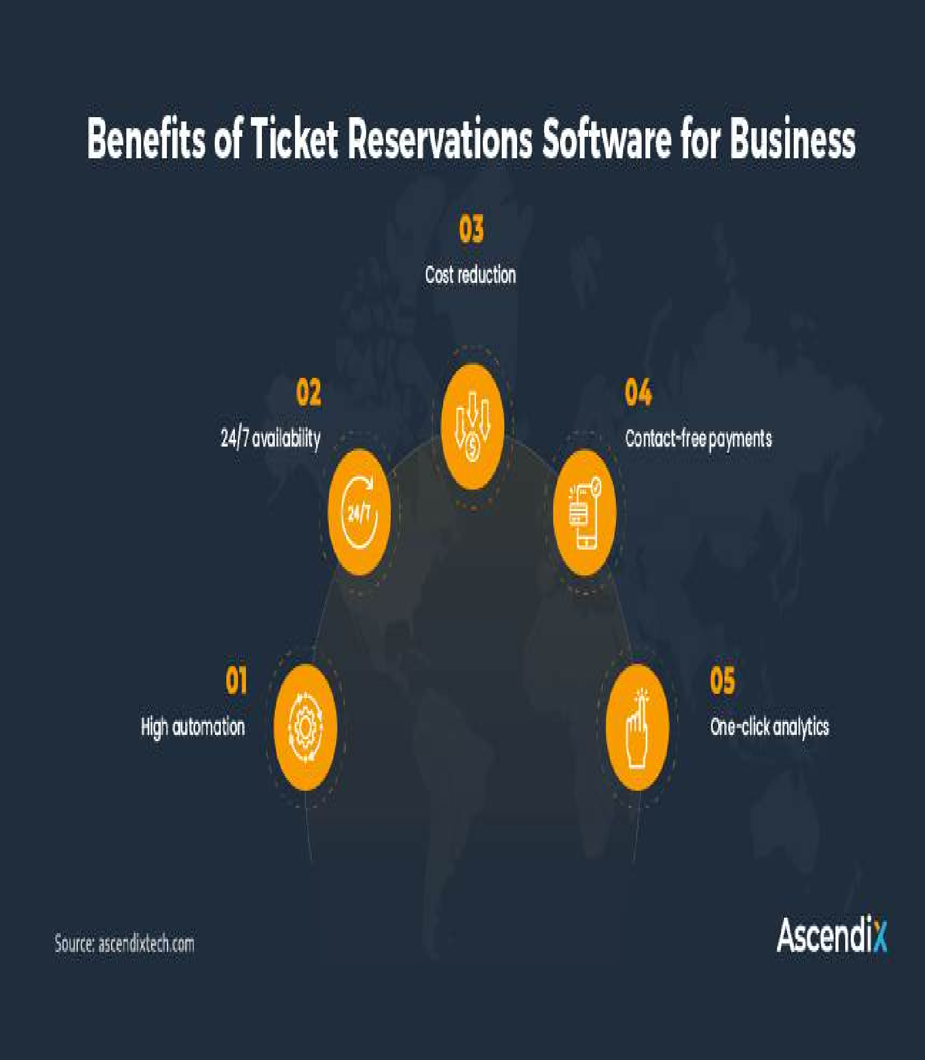

Architecture Diagram
The proposed system architecture integrates a user-friendly web/mobile interface, real-time data processing, and advanced analytics to deliver a comprehensive bus reservation solution.

Slide 6
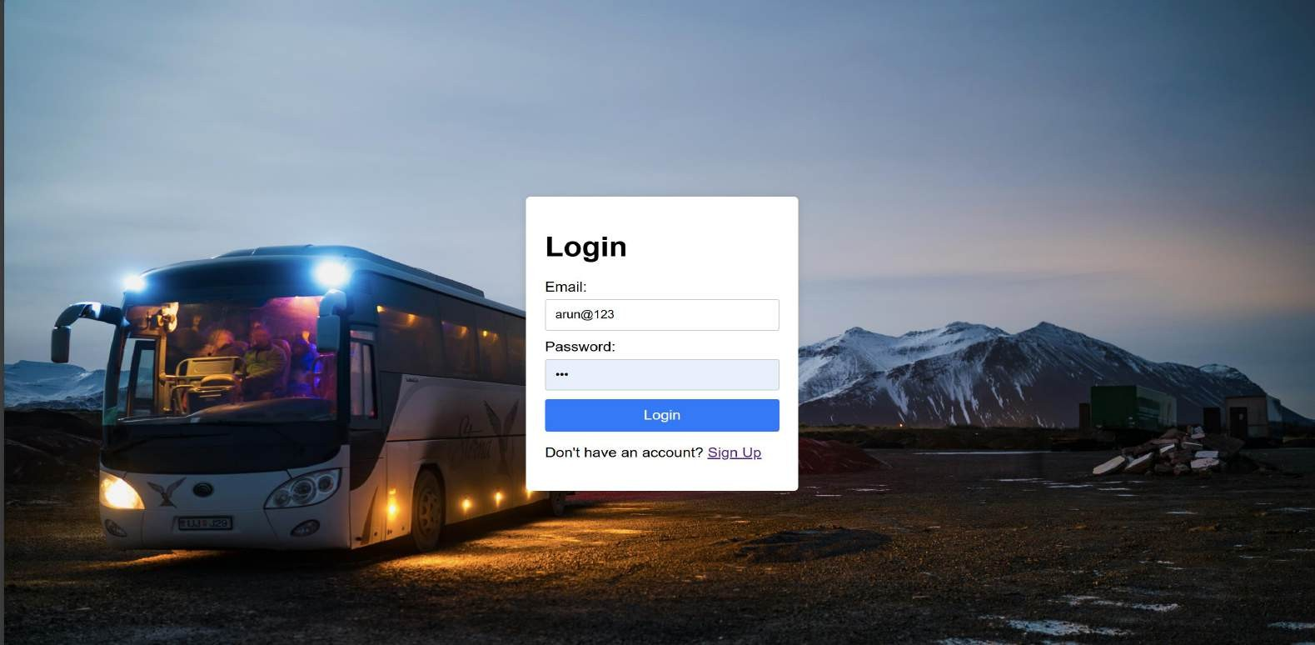
Key Modules
HTML&CSS
HTML is a markup language used to create static web pages and web applications. CSS is a style sheet language responsible for the presentation of documents written in a markup language.

Slide 7
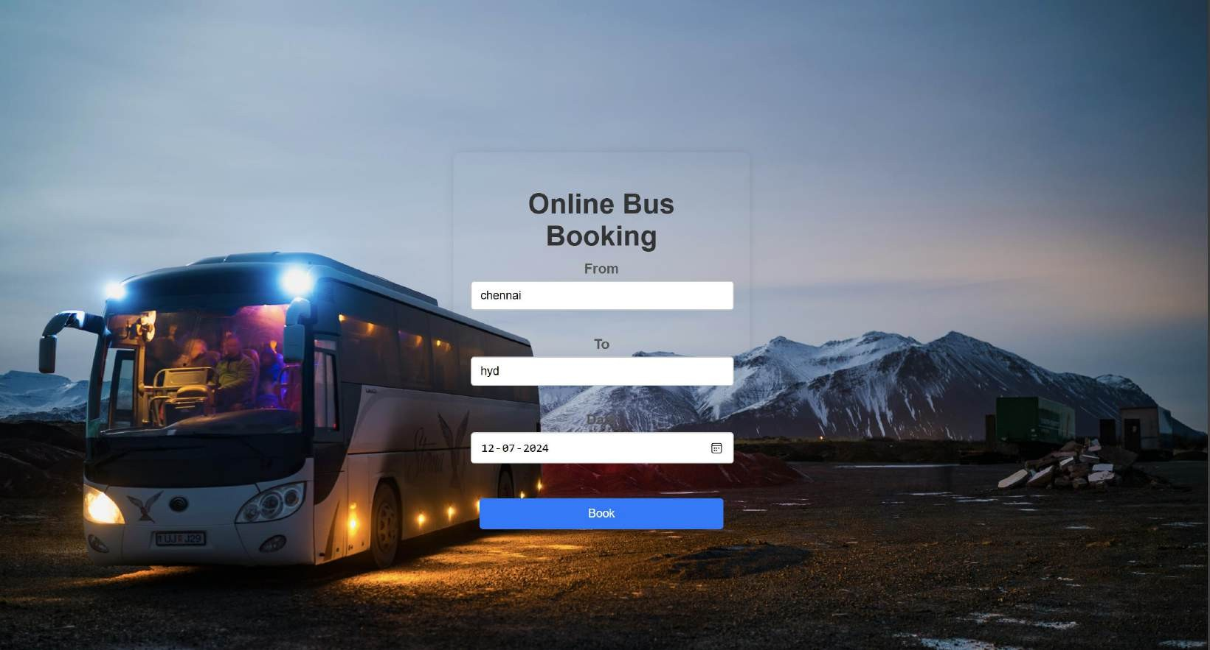
PHP:
HTML is a markup language used to create static web pages and web applications. CSS is a style sheet language responsible for the presentation of documents written in a markup language.

Slide 8
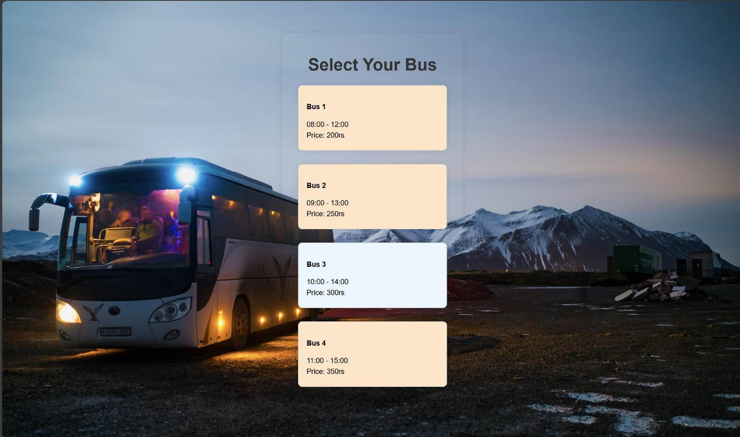

Slide 9
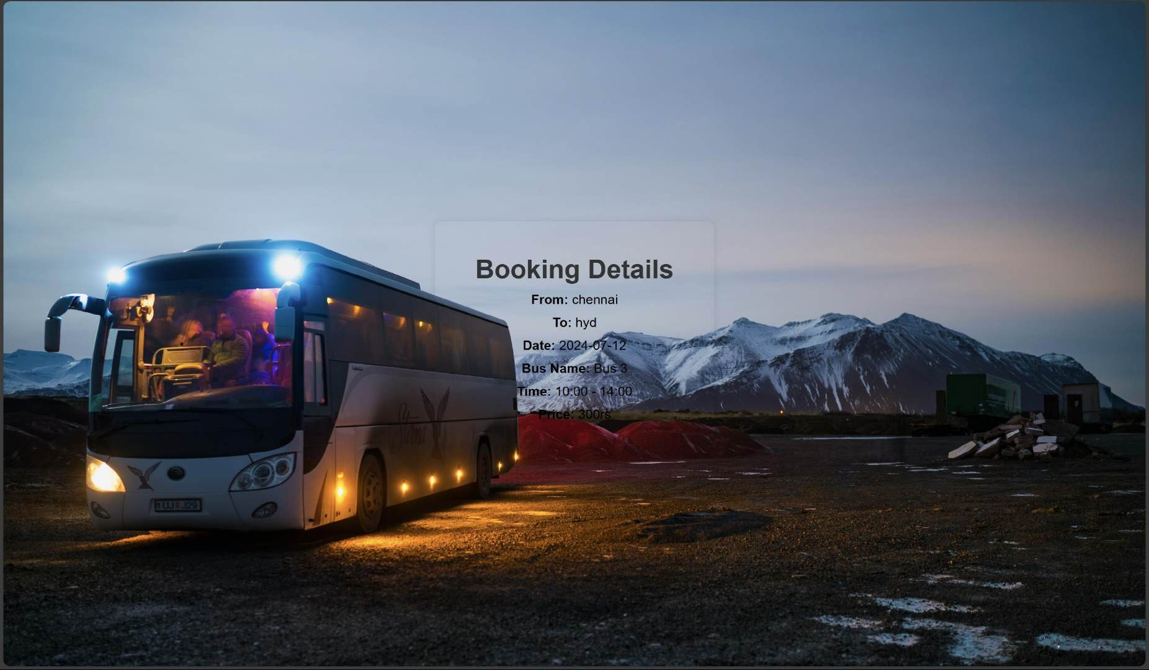

Slide 10

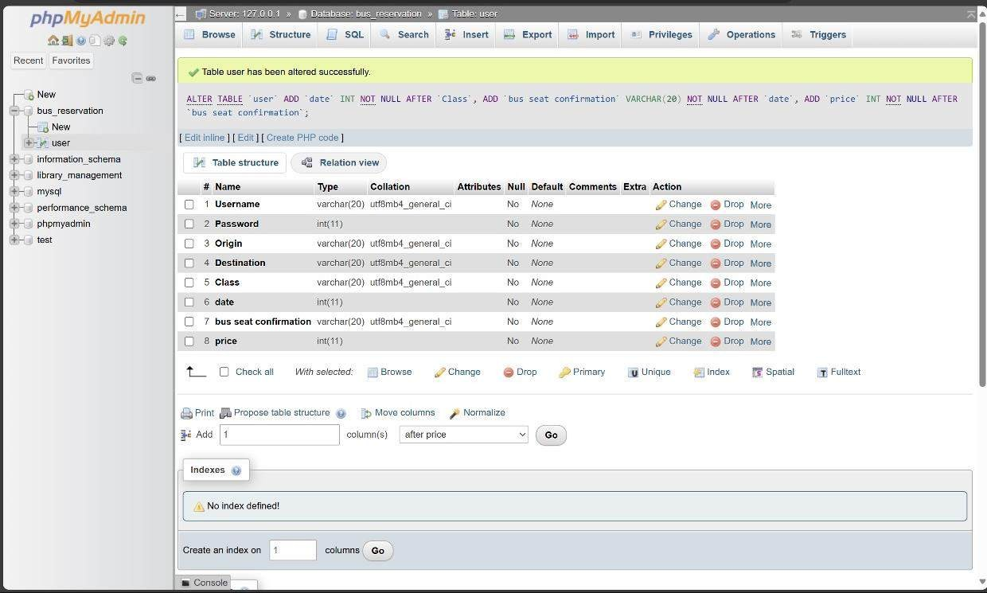
DATABASE OF BUS RESERVATION SYSTEM

Slide 11
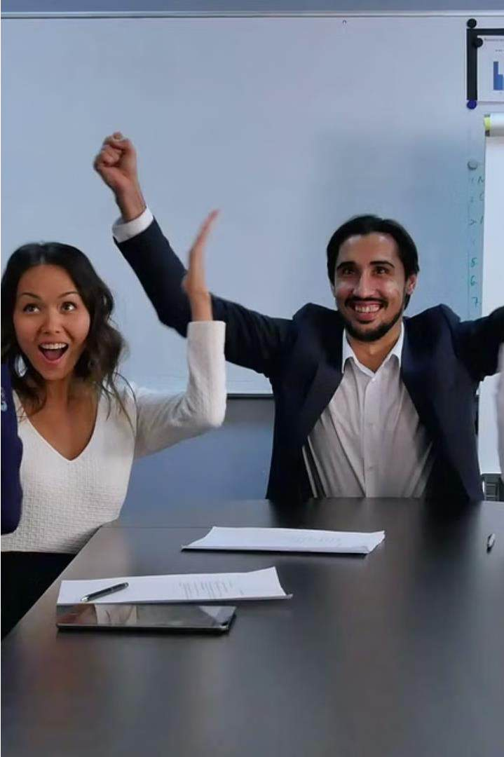
Conclusion
The proposed bus reservation system offers a comprehensive solution to transform public transportation, delivering enhanced passenger experience, operational efficiency, and data-driven decision-making for a smarter, more reliable bus service.

Slide 12
References
A Survey on Bus Reservation Systems Optimizing Bus Schedules and Improving Passenger Experience

Slide 13

Your Queńes Please!!!

Slide 14


